Slide 1
Local Security Agreements in Paris
Mathieu Zagrodzki
Université de Versailles/St-Quentin

Slide 2
Introduction
Paris: legal framework and political institutions

Slide 3
How is Paris governed?
A Mayor and a City Council elected by the people of Paris for six years
They set the budget and local taxes and are in charge of issues such as urban planning, transportation, social housing, city cultural institutions…
Limited powers in the field of security (unlike other Mayors in France): loitering, surveillance of municipal parks, street markets, stalls…
Bertrand Delanoë

Slide 4
How is Paris governed?
Twenty District Mayors and Councils (“Maires d’arrondissement” and “Conseils d’arrondissement”)
Powers restricted to the management of public local facilities: childcare centers, parks, libraries, gyms…
“Arrondissements” are not incorporated cities and their Mayors do not have a full jurisdiction
A mostly consultative role

Slide 5
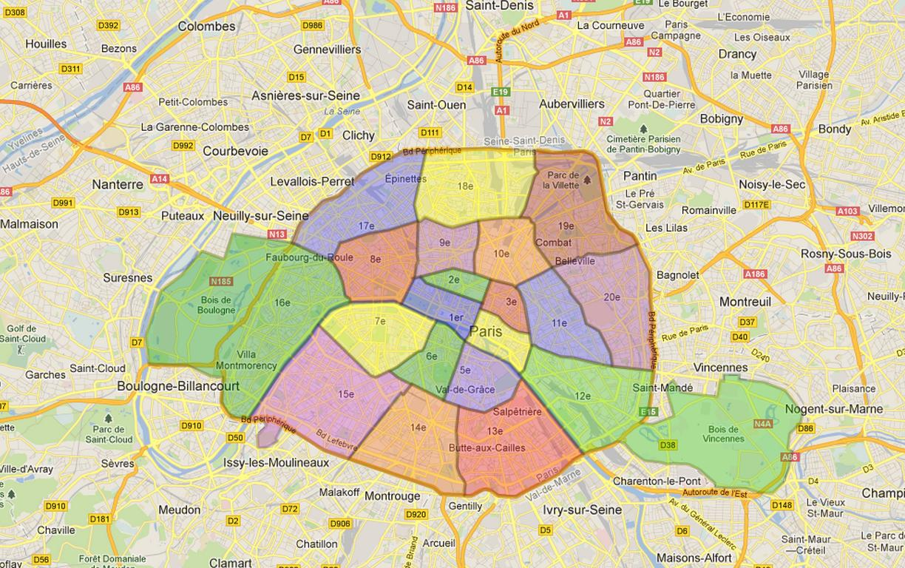
The 20 districts of Paris

Slide 6
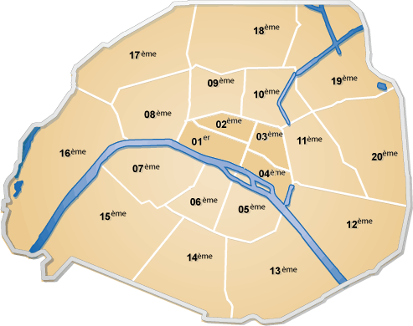

Slide 7
The specific governance of security in Paris: the Préfet de Police
The Préfet de Police is a civil servant appointed by the President of France and is in charge of public safety in Paris
He is at the head of a total of 46 000 agents, including 30 000 police agents
He has jurdisdiction over Paris and the surrounding suburbs
In charge of law enforcement (Chief of National Police forces in Paris) and traffic and parking rules in strategic areas (Champs-Elysées, Périphérique, embassies…)

Slide 8
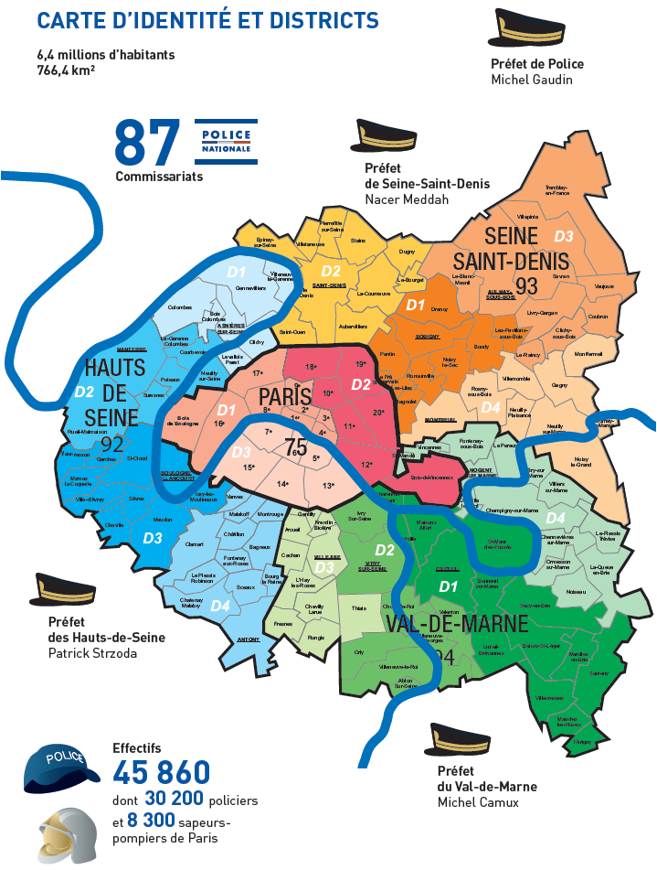

Slide 9
Local Security Partnerships in France
Brief history and legal framework

Slide 10
Local security partnerships in France
1983: Municipal Councils for Crime Prevention (“Conseils Communaux de Prévention de la Délinquance”) chaired by the Préfet
1997: Local Security Agreements (“Contrats Locaux de Sécurité”)
2002: Local Councils for Security and Crime Prevention (municipal or inter-municipal level), chaired by the Mayor
2007: Local Councils are made mandatory for all municipalities with a population of 10 000 or more and for municipalities with a sensitive area

Slide 11
The Parisian Security Agreement
A dual system that replicates Paris’s specific administrative structure

Slide 12
Some key facts about the Parisian Security Agreement
The first Security Agreement was signed in 2000
The current one was signed in March 2009 by the Mayor, the Préfet de Police, the Chief Prosecutor of Paris, the Director of the Paris School System and the Préfet of the Paris Region
Co-presided by the Préfet de Police, the Mayor and the Chief Prosecutor, chaired by the Mayor
A two-level approach: the City agreement+ City Security Council and the District agreements + District Security Councils

Slide 13
The City level
How do the Agreement and the Council work?

Slide 14
Who are the members of the Council?
Four types of actors
Those members are appointed by the Préfet de Police, after consulting the Mayor and the Chief Prosecutor
The Council meets at least twice a year
Members of the City Council
President of the Court, Sentence Enforcement Judge, Judge from the Juvenile Court
Officials of the State, school system, prison system and City of Paris
Transportation
Social Housing
NGOs specialized in Crime and Drug Prevention

Slide 15
The role of the Agreement
The Council monitors the enforcement of the Agreement
Deals with citywide or cross-district problems
A general framework for District Agreements
A consultation, a diagnosis and an action plan

Slide 16
The content of the Agreement: the shared diagnosis
The diagnosis is made of three components:
Safety diagnosis:
Official Crime statistics (Police and Justice)
Incidents recorded by transportation or social housing companies and City of Paris personnel
Victimization survey
An analysis of the actions undertaken since 2002 by the Police, the Justice system and the City of Paris (drugs, juvenile crime, victims assistance, road safety…)
An assessment of District Agreements since 2002 and guidelines for their improvement

Slide 17
The content of the Agreement: the common action plan
5 priorities
General objectives, beneficiaries, methodology, institution(s) in charge, calendar, cost, expected results and indicators used
Public Safety and Crime Prevention | Assisting the victims | Drug and alcohol addictions | Sectarian groups | Domestic violence
Juvenile crime, assaults, CCTV, road safety | Legal and psychological assistance in police stations | Youth addiction, drug trafficking | Prevention campaigns, assisting former members of those groups | Prevention, enforcement, legal and psychological assistance

Slide 18
The District level
A deconcentration of public safety partnerships at the local level

Slide 19
District Agreements and Councils: key facts
A flexible and non-mandatory tool that is an extension of the City plan of action
19 out of 20 “arrondissements” have signed a “Contrat de Sécurité d’Arrondissement”
19 out of 20 “arrondissements” have a “Conseil de Sécurité et de Prévention de la Délinquance d’Arrondissement”
Districts have to follow the guidelines established by the City Agreement but may adjust the action plan to local needs (i.e. add a priority that is not in the Paris action plan)

Slide 20
District Agreements: how they work
A similar structure to the City Agreement: safety diagnosis, assessment of previous actions, plan
The possibility to create partnerships with neighboring municipalities or districts in case of cross-border problems
Local plans are monitored by the City, which appointed Local Security Agreements and Partnerships Coordinators for each district
Each District Agreement has a steering committee: District Mayor, Police, Justice and the aforementioned coordinator
Each district may create specialized working groups

Slide 21
District Councils: how they work
Co-Presided by the District Mayor, the Local Police Station Chief and the Prosecutor
Other members are: District Council members, City and School officials, transportation companies, social housing companies, neighborhood council members
District Councils may invite other persons on a permanent or occasional basis (i.e. Mayor of a neighboring district)
The council meets once or twice a year

Slide 22
Conclusion
Towards an increased accountability?

Slide 23
Conclusion
City Security Agreement+ City Security Council
Key actors: Préfet de Police, Mayor, Prosecutor
Agreement: sets a global action plan for citywide issues and guidelines for the local agreements
Council: supervises the implementation of the action plan
District Security Agreements+ District Security Councils
Key actors: District Mayors, Local Police Station Chief, Prosecutor, City Partnerships Coordinator
Agreements: local action plans in the framework established by the City Agreement
Councils: supervise the implementation of the action plan and deal with everyday issues through the steering committee

Slide 24
Conclusion: the benefits of the system
Increased accountability and legitimacy through citizens’ and civil society input
Partnerships and « coproduction »: the Police force is part of a collective effort in the field of security

