Slide 1
Trust in the police, legitimacy and compliance with the law
Professor Mike Hough
University of London
Ankara 24th January 2013

Slide 2
What I’ll discuss
Using surveys to measure trust in the police
Findings from the European Social Survey
Implications for policing

Slide 3
Why do we obey the law?
Mainly because we think it is right to do so
But also because we think the police and courts have legitimate authority
Legitimacy creates
Compliance with the law
Cooperation with the police

Slide 4
Definition: the police have legitimacy when:
The policed offer their willing consent to the police
Because they believe that:
the police act fairly, honestly and legally
And share their moral values

Slide 5
What creates police legitimacy?
Fair treatment
Fair outcomes
Fair procedures
Respectful treatment
Giving people ‘voice’
Competence

Slide 6
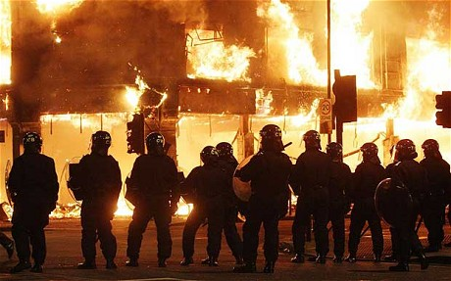
The risks of losing legitimacy

Slide 7
Using surveys to measure trust
EU Euro-justis project
The European Social Survey
The Crime Survey for England and Wales
The METpas survey in London

Slide 8
What does the ESS measure? Public perceptions of:
Police fairness
Police effectiveness
Police legitimacy
Risks of punishment for ‘everyday’ crimes
Self-reported law-breaking
Preparedness to cooperate with police

Slide 10
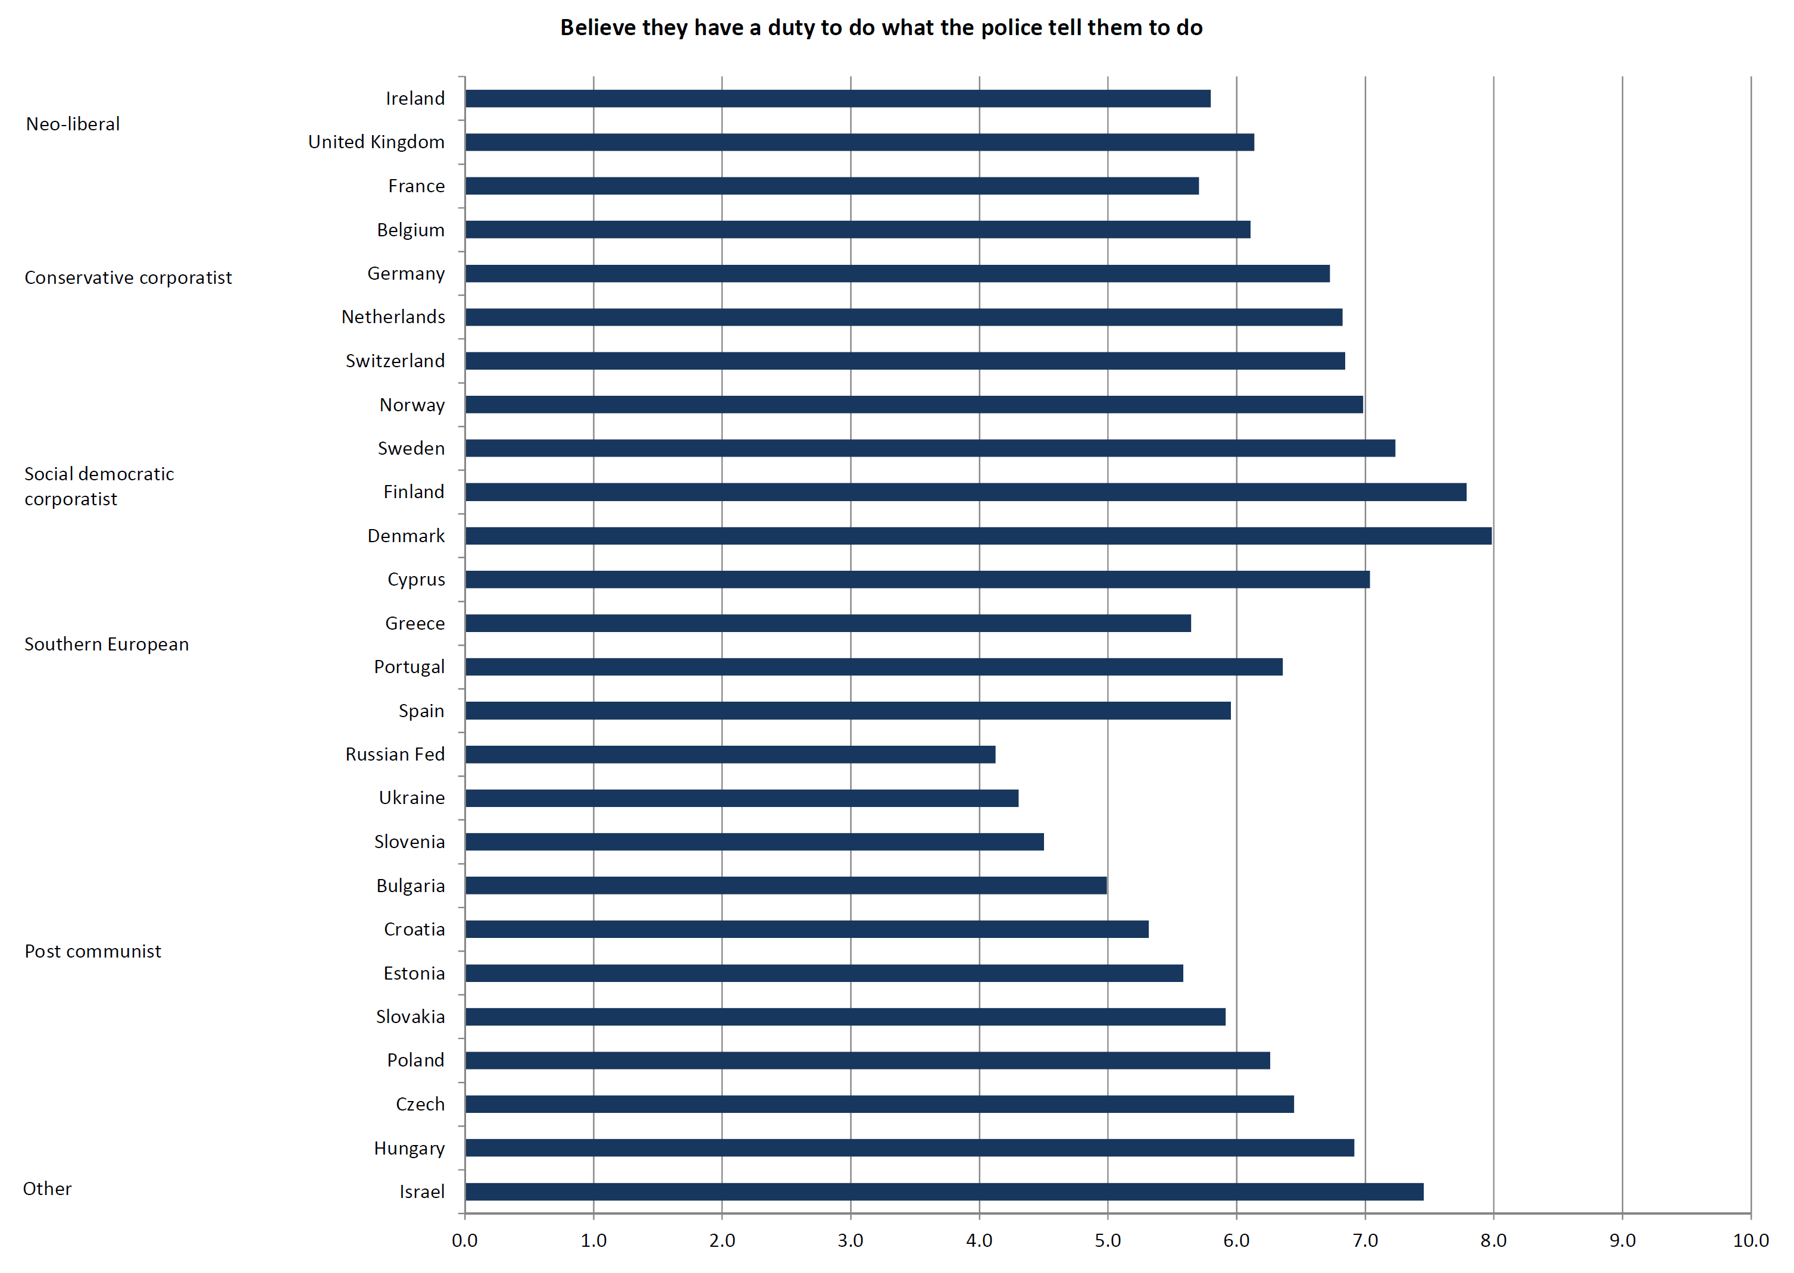

Slide 11
Trust, legitimacy and consent to the rule of law: our theory
Fair and respectful treatment Trust
Trust Legitimacy
Legitimacy Compliance
Legitimacy Cooperation

Slide 12
Value of these surveys to policing policy
They provide a framework for thinking about effective policing
They show that fair policing is an essential component of effective policing
They suggest the best ways of building police legitimacy
Interest in UK from Home Office, College of Policing, Ministry of Justice, the Police Inspectorate and The Metropolitan Police

Slide 13
Trust in the police, legitimacy and compliance with the law
Professor Mike Hough
University of London
Ankara 24th January 2013

